Slide 1

AI System Design

Slide 2

What Is AI System Design?
Core Definition
An AI system makes intelligent decisions based on data, learns from patterns, and improves over time. AI System Design focuses on architecting data ingestion, training, deployment, and inference layers for scalability, efficiency, and fault tolerance.
Distinguish between Predictive AI (ranking, classification) and Generative/Agentic AI (content creation, autonomous tasks). The architectural constraints for latency and cost differ significantly between them.
Modern systems go beyond prediction — they use ReAct (Reason-Act) loops to autonomously execute complex workflows.

Slide 3
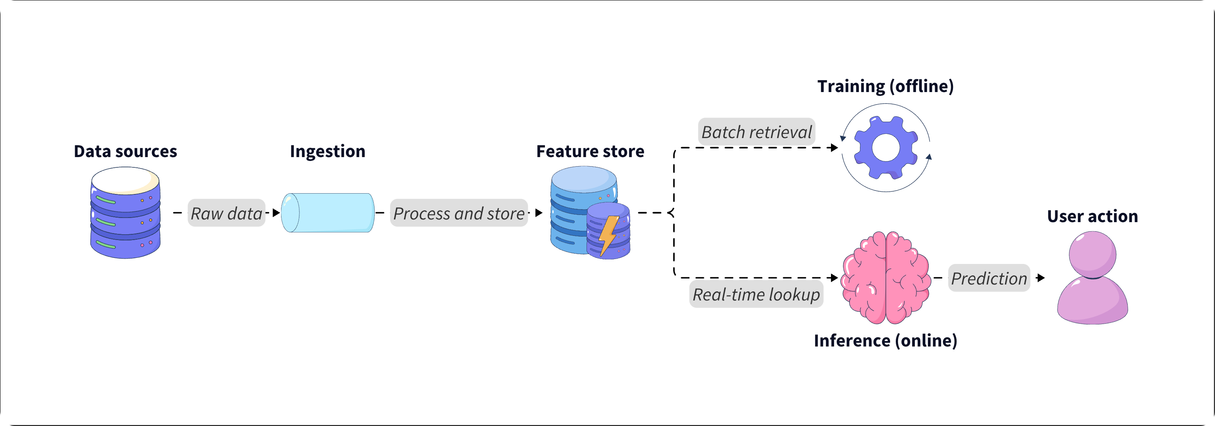
The ML Pipeline: A High-Level Overview
Data flows from sources into ingestion, moves through a feature store, then splits into offline training and online inference pipelines — ultimately powering user-facing actions.
This ecosystem illustrates how raw data becomes predictions: ingested, processed, stored as features, trained offline, and served in real time.

Slide 4
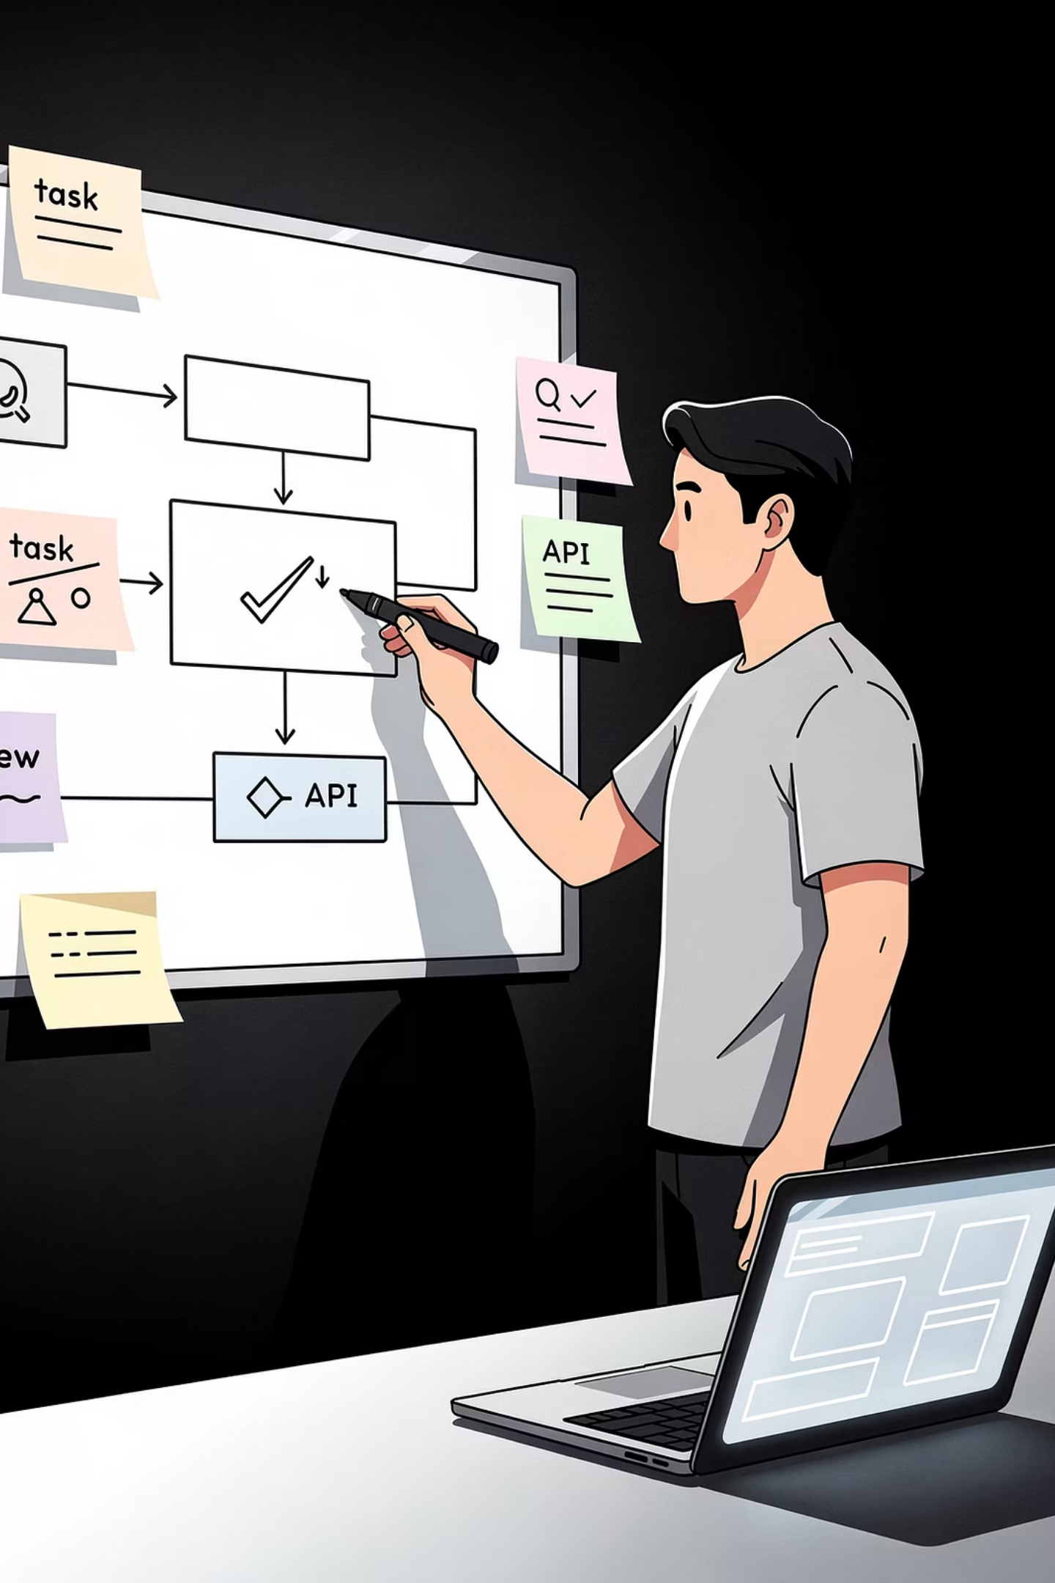
Scoping the Problem Space
Before drawing a single box, always clarify constraints.
Data Types
Latency Needs
Retraining Cadence
Images, text, transactions — what format is the input?
What are the real-time prediction requirements?
How often does the model update and how is feedback incorporated?
LLM Context
Context window limits and long-term memory requirements for session persistence.

Slide 5





Core Objectives of AI System Design
Accuracy
Scalability
Latency
Reliable predictions; reduce hallucinations in generative models.
Handle growing datasets via distributed training and sharding.
p99 under 200ms for ranking; streaming tokens for LLMs.
Adaptability
Observability
Learn from new data via feedback loops or online learning.
Track data drift, model bias, and enable auditing and explainability.

Slide 6
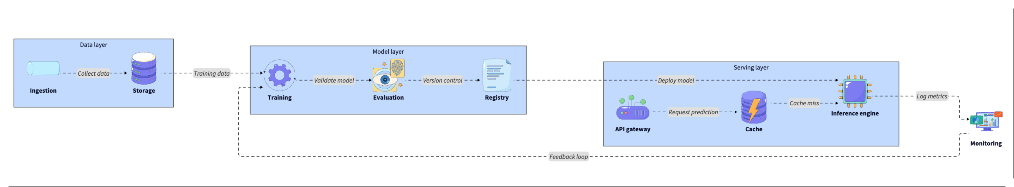
High-Level Architecture: Three Core Layers
A typical AI system is divided into three main layers — data, model, and serving — with an optional orchestration layer for multi-agent workflows.
Data Layer
Model Layer
Serving Layer
Collection, storage, preprocessing, and feature store for offline/online consistency.
Training, validation, feature engineering, distributed training (MoE), and model registry.
Real-time inference via APIs, monitoring, logging, feedback loops, and MCP for agentic systems.

Slide 7

Key Components of an AI System
01
02
Data Ingestion & Preprocessing
Feature Store
Collect, clean, tokenize, and standardize data. Tools: Apache Kafka, Airflow, Spark.
Ensures offline/online consistency. Tools: Feast, Redis (online), BigQuery (offline).
03
04
Model Training Pipeline
Model Registry
GPU/TPU-scale training with backpropagation. Tools: TensorFlow, PyTorch, Ray, Kubeflow.
Tracks versions, metadata, hyperparameters, and lineage. Tools: MLflow, SageMaker.
05
06
Model Serving & Inference
Monitoring & Feedback
Real-time deployment, scaling, routing. Tools: TensorFlow Serving, FastAPI, ONNX Runtime.
Track drift, bias, and performance. Tools: Prometheus, Grafana, Evidently AI.
Watch out for training–serving skew: always use a unified feature store to ensure the same features are used in both training and real-time inference.

Slide 8
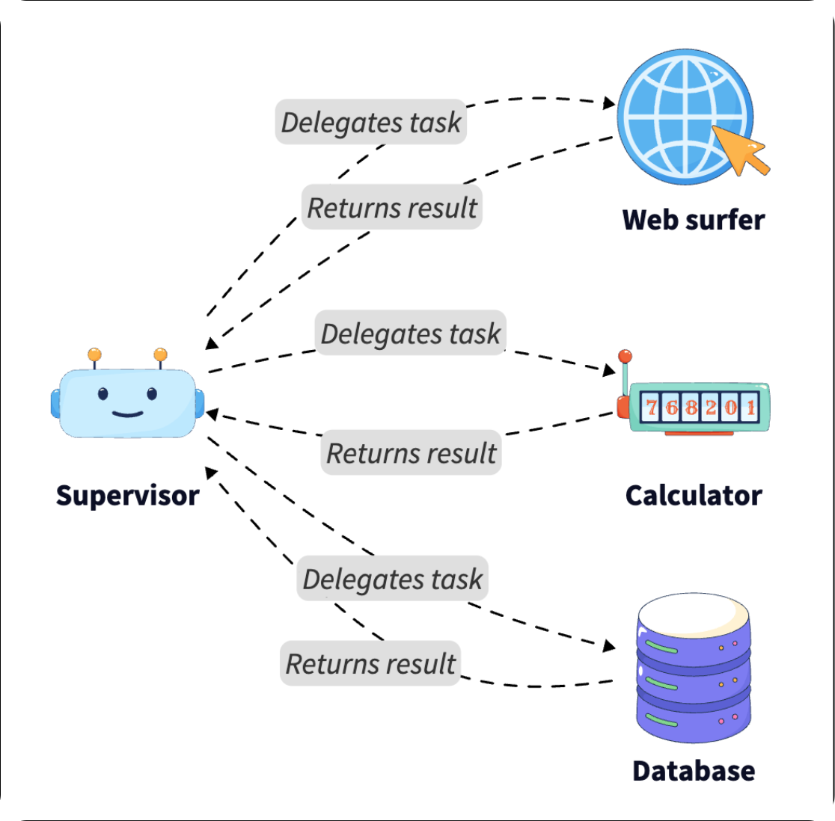
Agentic AI & Multi-Agent Patterns
Orchestrator-Worker Pattern
Reasoning Patterns & Memory
A central Orchestrator LLM breaks complex queries into subtasks and delegates them to specialized Worker agents (e.g., Coder Agent, Search Agent), then synthesizes results — more reliable than a single monolithic model.
ReAct loops let models reason before acting. Tree-of-Thought / Graph-of-Thought explore multiple paths for complex challenges. Agents also need short-term memory (session context) and long-term memory in a vector database for personalized, coherent responses.

Slide 9
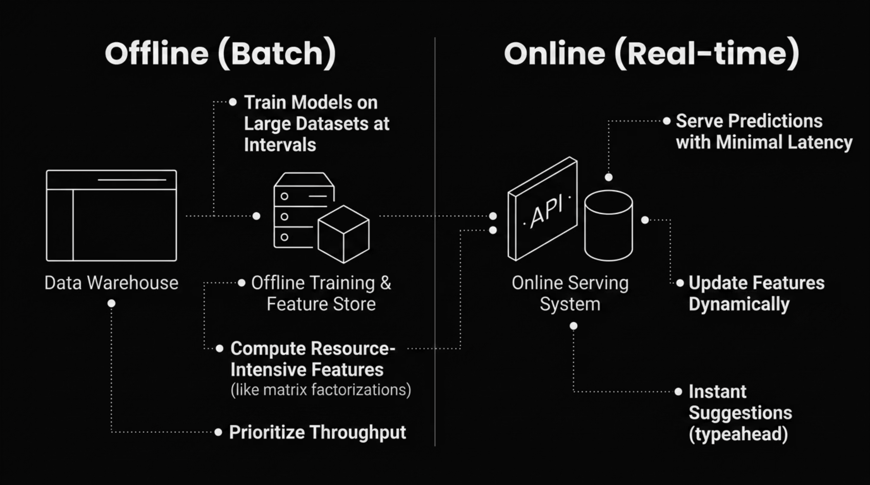


Offline vs. Online Components
Use batch–stream hybrid architectures (Lambda or Kappa-style) to merge batch and streaming views, giving your model access to both historical depth and real-time freshness.

Slide 10

Scalability & Performance
Data Sharding
Partition data across nodes so no single machine becomes a bottleneck.
Distributed Training
Spread computation across GPU clusters using data or model parallelism.
Model Compression
Quantization (FP16 → INT8) reduces memory usage and speeds up inference.
Caching & Load Balancing
Cache frequent predictions; distribute inference traffic across replicas for consistent response times.

Slide 11

Caching in AI Systems
Cache Types
Semantic Caching
Instead of exact query matches, the system embeds incoming queries and searches a vector database for semantically similar past requests. "Shoe store" and "footwear shop" can share a cached response.
Feature Cache
Stores computed features for reuse across sessions.
Model Cache
Large-scale LLM systems use semantic caching to reduce repeated GPU computation for frequently repeated prompts — saving significant compute cost.
Keeps model weights resident in GPU memory to avoid cold starts.
Prediction Cache
Stores outputs for frequently repeated queries.

Slide 12
Indexing & Retrieval
Efficient indexing is critical for recommendation and RAG (retrieval augmented generation) systems. Without it, even accurate models fail to respond within acceptable latency bounds.
Vector Indexing
Inverted Indexes
Trie-Based Structures
Standard for semantic search. Embeddings stored in Pinecone or Milvus. HNSW algorithms enable approximate nearest-neighbor searches balancing recall and performance.
Remain effective for keyword-based retrieval in traditional search scenarios.
Well-suited for prefix searches in autocomplete and typeahead scenarios.
These approaches often coexist: a typeahead system uses Trie-based indexing for fast prefix lookups while an AI retrieval layer uses vector databases for semantic results.

Slide 13
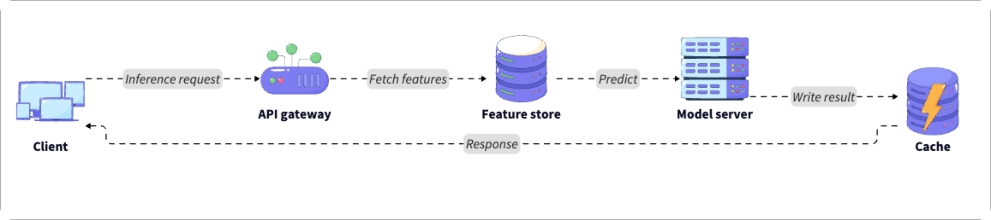
Real-Time Inference Pipeline
The inference pipeline is the "hot path" of your architecture — handling requests that need immediate responses. Micro-batching processes multiple requests simultaneously for efficiency without added latency.
Example: A fraud detection system receives a payment transaction, retrieves the customer's historical data, and runs an ML model to approve or flag the transaction within milliseconds.

Slide 14
Data Freshness & Model Deployment
Keeping Data Fresh
Deployment Strategies
Streaming updates refresh features immediately after events. Micro-batching offers near-real-time updates when full streaming is impractical. Versioned datasets help recover from corruption or unexpected errors.
Canary deployment: Roll out to a small user subset first to test stability.
Shadow deployment: Run new model alongside old on real traffic without affecting users.
A/B testing: Compare models using user feedback or business metrics.

Slide 15

Fault Tolerance & Reliability
Redundancy
Replicate critical services across multiple nodes to prevent single points of failure.
Retry Logic
Automatically reattempt failed inferences to handle transient network issues.
Circuit Breakers
Isolate failing components to prevent cascading outages across the system.
Fallback Models
If a large frontier model (e.g., GPT-4–scale) is unavailable, automatically switch to a smaller 7–8B parameter model to maintain service.

Slide 16
Monitoring, Privacy & Security
Observability Metrics
Privacy & Security (AI TRiSM)
Latency: p95 and p99 response times
Throughput: Requests per second
Model performance: Precision, recall
Data/feature drift: Input distribution changes over time
Anonymize/pseudonymize user data; encrypt at rest and in transit
GDPR and CCPA compliance, including "right to be forgotten"
Input validation to block prompt injection attacks
Differential privacy during training to prevent PII leakage
Role-based access control to limit API access
Tools: Prometheus, Grafana, ELK Stack.

Slide 17
Example: AI-Powered Recommendation Engine
PRACTICAL DESIGN
1
2
3
Define Requirements
Design Architecture
Define Workflow
Personalized recommendations updating in near real-time. Predictions served under 200ms with accuracy, scalability, and reliability.
Kafka for clickstream ingestion → S3 + Cassandra for storage → Two-Tower model for retrieval → XGBoost/deep learning for ranking → TensorFlow Serving/FastAPI → Redis cache.
User logs in → fetch cached recommendations (or vector search for 1,000 candidates on cache miss) → ranking model scores and returns top N → user feedback streamed via Kafka to asynchronously update features.

Slide 18
Key Trade-Offs in AI System Design
Every AI system requires balancing multiple dimensions. In 2026, managing the trade-off between agent autonomy and operational cost is among the most pressing challenges.
Accuracy vs. Latency
High-accuracy models (e.g., large transformers) are slower and more expensive to run.
Batch vs. Real-time
Batch processing is cheaper and easier to manage but suffers from data staleness.
Complexity vs. Maintainability
Microservice agent architectures are flexible but harder to debug than monoliths.
Cost vs. Redundancy
More replicas improve reliability but linearly increase infrastructure costs.
Autonomy vs. Control
Agentic systems are powerful but harder to predict; strict guardrails reduce capability but increase safety.

Slide 19
Structuring Your AI System
Clarify the Problem
1
Ask about data types, latency requirements, and scale.
Estimate Scale
2
Approximate user count, request volume, and storage needs.
Propose Architecture
3
Include data, model, and serving layers at a high level.
Dive Into Specifics
4
Discuss caching, indexing, and fault tolerance in detail.
Discuss Trade-Offs
5
Highlight scalability vs. cost, accuracy vs. latency.
Recommend Improvements
6
Suggest evolving the system with agentic capabilities or better MLOps.

Slide 20
Key Takeaways
Hybrid Architectures
Lifecycle Management
AI System Design combines traditional distributed systems with ML workflows and modern agentic patterns.
Architecture must include data ingestion, training, serving, and continuous feedback loops.
Performance Optimization
Production Readiness
Semantic and feature caching plus vector indexing are crucial for latency and scalability.
Fault tolerance, monitoring, governance (AI TRiSM), and privacy are required for all production systems.
Mastering AI System Design prepares you to address machine learning and distributed systems challenges in any interview setting.

